Slide 1
ARRA Event Study
Ata Güvendi

Slide 2
The Events
In 2008, Food Stamps were renamed to be the Supplemental Nutrition Assistance Program.
In 2009, post 2008 crisis, the American Recovery and Reinvestment Act of 2009 (ARRA) gave an $831B stimulus package, 40B of which was in SNAP stimulus.
Benefit ended 2013 (~November) because of the Healthy Hunger-Free Kids Act which drew more resources, ending the program earlier than expected (2014).
Benefits per household reduced in the high single digits (7-8%).

Slide 3
My Data
I merge 4 panels (county x year):
ACS (American Community Survey Data): Records SNAP utilization percentage
SAIPE (Small Income and Poverty Estimates):
Poverty percentages (all, children etc.), median household income
LAUS (Local Area Unemployment Statistics): Unemployment rate, labor force count
MMG (Map the Meal Gap): Data retained by Feeding America (NGO). See next slide.
Data Ranges: 2010-2017, 816 counties (<7 observation counties excluded)

Slide 4

MMG
Contains these markers:
Number of Food Insecure (FI) and Rate
Children FI and Rate
Cost per Meal ($)
Weighted Annual Food Budget Shortfall (WAFBS)
$$FI ∗Shortfall \left(USD\right)∗52 ∗\left(\frac{7}{12}\right)$$
7/12 factor motivated by Household Food Security in the United States in 2023 (Rabbitt et al., 2024).
“Weighted by the national “cost of food index”.

Slide 5

The Treatment
To conform to the binary treatment setup, I define counties that are more intense in SNAP usage as the ones that are treated, because they are likely to feel the more pronounced effect of the cut.
Define cutoff parameter θ in [0,1], where:
$$τ = 1\{SNAP ≥\text{θ}\}$$

Slide 6
The Design
Using standard DiD Event Study (no pooling at end years)
Drop 2012 for multicollinearity, index years:
-3 = 2010
0 = 2013 (partially treated year, recall November Cutoff)
4 = 2017
Use TWFE with treatment dummies τ

Slide 7
Some Preset TWFE Regressions

Slide 8
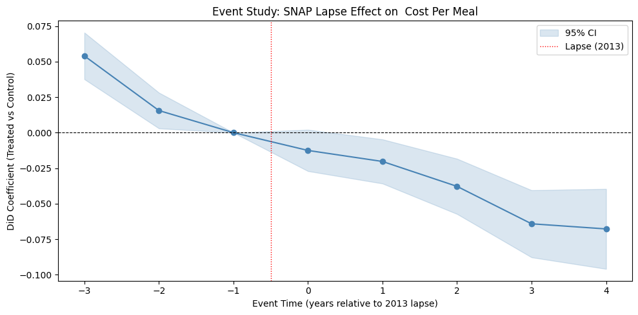
Cost Per Meal ($)
Spec: θ=0.3, Controls = [Unemployment Rate (%)]

Slide 9
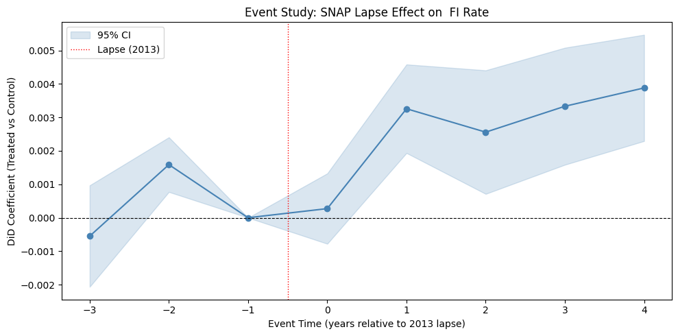
FI Rate
Spec: θ=0.3, Controls = [Unemployment Rate (%)]

Slide 10
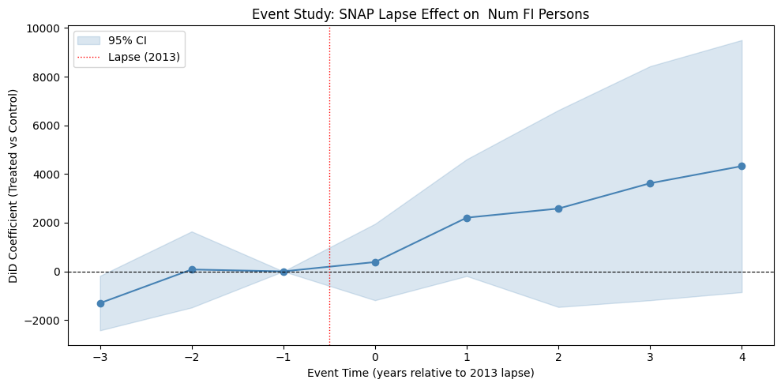
Num FI Persons
Spec: θ=0.3, Controls = [Unemployment Rate (%)]

Slide 11
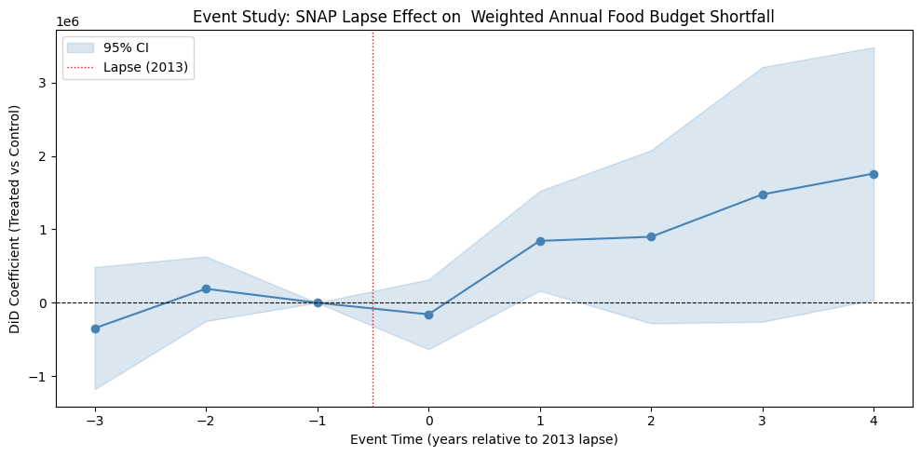
Side By Side: What is Increasing?
$$WAFBS = FI ∗Shortfall \left(USD\right)∗52 ∗\left(\frac{7}{12}\right)$$

Slide 12
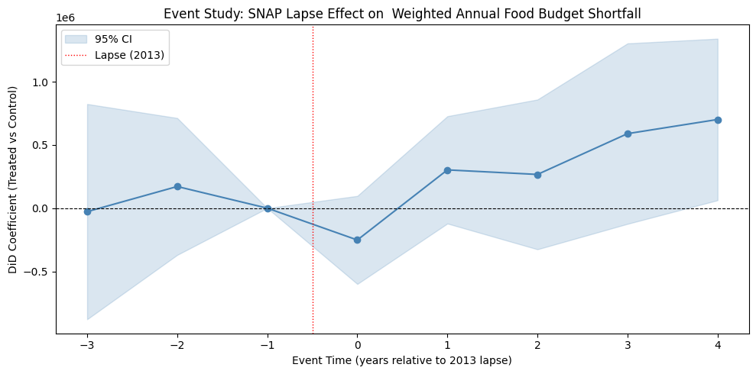
WAFBS
Spec: θ=0.3, Controls = [Unemployment Rate (%), Num FI]

Slide 13
WAFBS
Spec: θ=0.3, Controls = [Unemployment Rate (%), Num FI]
Takeaway:
The number of insecure individuals (FI) is increasing, but so is the per person shortfall.
More hungry people, and the hungry are hungrier.

Slide 14
Quantifying Results
Variable | Coef. (USD) | 95% CI | p
Pre-treatment periods
t − 3 | −27,670 | [−878,700, 823,400] | 0.949
t − 2 | 171,200 | [−370,200, 712,600] | 0.535
Post-treatment periods
t + 0 | −251,600 | [−599,800, 96,510] | 0.157
t + 1 | 302,600 | [−121,800, 726,900] | 0.162
t + 2 | 266,600 | [−325,600, 858,800] | 0.378
t + 3 | 589,100 | [−124,400, 1,303,000] | 0.106
t + 4 ** | 701,000 | [62,350, 1,340,000] | 0.032
Controls
Unemployment rate (%) | 90,530 | [−79,460, 260,500] | 0.297
Num FI persons *** | 244.78 | [211.34, 278.22] | <0.001

Slide 15

Quantifying Results
$$WAFBS = \overline{FI} ∗Shortfall \left(USD\right)∗52 ∗\left(\frac{7}{12}\right)$$
Thus, shortfall per person is $34.6 monthly, $8.07 weekly, or $1.15 daily.
Congressional Research Service Report R41374 cites the effects of the ARRA cut on dollar losses in subsidies as:
Household Size | Monthly Dollar Loss p.p.
1 | 24
2 | 22
3 (most common) | 21
4 | 20

Slide 16
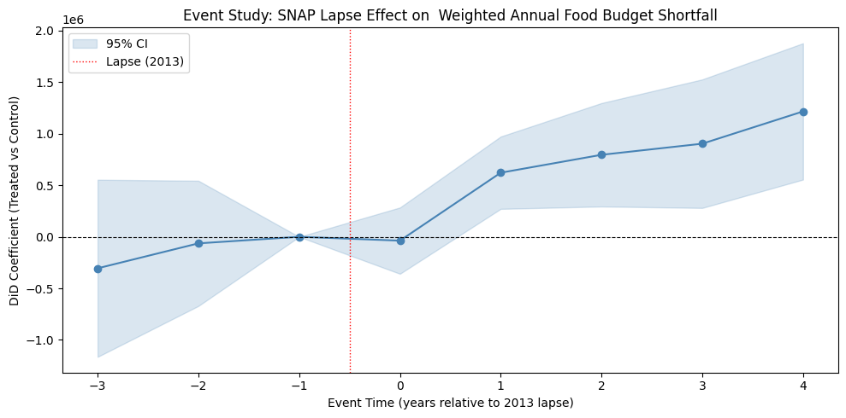
WAFBS
Spec: θ=0.3, Controls = [Num FI, Labor Force]

Slide 17
Quantifying Results
Variable | Coef. (USD) | 95% CI | p
Pre-treatment periods
t − 3 | −305,400 | [−1,164,000, 553,400] | 0.486
t− 2 | −63,530 | [−670,700, 543,700] | 0.838
Post-treatment periods
t + 0 | −37,290 | [−358,700, 284,100] | 0.820
t + 1 *** | 621,400 | [270,500, 972,300] | 0.001
t + 2 *** | 795,100 | [293,500, 1,297,000] | 0.002
t + 3 *** | 902,800 | [279,600, 1,526,000] | 0.005
t + 4 *** | 1,216,000 | [554,700, 1,877,000] | <0.001
Controls
Num FI persons *** | 309.80 | [267.72, 351.88] | <0.001
Labor force *** | 196.73 | [141.82, 251.64] | <0.001

Slide 18

Quantifying Results
$$WAFBS = \overline{FI} ∗Shortfall \left(USD\right)∗52 ∗\left(\frac{7}{12}\right)$$
Thus, shortfall per person is $43.77 monthly, $10.21 weekly, or $1.46 daily.
Congressional Research Service Report R41374 cites the effects of the ARRA cut on dollar losses in subsidies as:
Household Size | Monthly Dollar Loss p.p.
1 | 24
2 | 22
3 (most common) | 21
4 | 20

Slide 19
Plans for Robustness Checks
Placebos:
I don’t have a lot of pre-trend years, so I am searching for an outcome placebo (something completely exogenous)
Pre-trend falsifications all pass (not shown), all treatments not statistically significant
Varying θ

